Slide 1
Presentation Notes
This entire deck, including demos but not the checkpoints, must be delivered in 10 minutes or less. Participants need time to do the actual lab.
Talking points are very brief. Even if you’ve seen the same slide in the past, take note of the new talking points.

Slide 3
Mobile DevOps 3 Continuous Deployment and Beta Testing using Visual Studio Team Services and HockeyApp
Code Labs

Slide 4
Mobile DevOps Modules
1
Cross Platform Mobile Development with Xamarin
2
Continuous Integration using Visual Studio Team Services for Cross Platform Mobile Apps
3
Continuous Delivery for Cross-Platform Mobile Apps using Visual Studio Team Services and HockeyApp

Slide 5






Continuous Integration & Delivery Solutions for Mobile Apps
Automate and orchestrate your build, test and release processes
Smooth deployment and beta testing of mobile apps
Close the loop between Development and Operations
Microsoft products related
Visual Studio Team Services and TFS
HockeyApp
Developer
Operations

Slide 6












Team Build (CI)
Test & Code Coverage
apk
Release
Management
with Approvals
git push
Bug Tracking
HockeyApp
Crash Reports
& Feedback
apk
UWP
Debugging in Visual Studio
Unit Test
HockeyApp
Update Manager
Emulator
apk
Simulator

Slide 7
Module 3
Release Management
Continuous Deployment
Update Management
Crash and Feedback Management
Team Build (CI)
Test & Code Coverage
apk
Release
Management
with Approvals
git push
Bug Tracking
HockeyApp
Crash Reports
& Feedback
apk
UWP
Debugging in Visual Studio
Unit Test
HockeyApp
Update Manager
Emulator
apk
Simulator

Slide 8
Lab Module 3 - CD

Slide 9
Module Exercises
Creating a HockeyApp Account
Creating a VSTS Release Definition
Tracking User Feedback
Tracking App Crashes

Slide 10
Wrap Up
Created a HockeyApp account
Created a VSTS Release Definition with a HockeyApp task
Queued the Release manually and install the app via HockeyApp in the emulator
Tracked feedback from within the app
Tracked app crashes from HockeyApp

Slide 11


Checkpoint
Notes:
Time: TBD

Slide 12
Wrap Up
Notes:
Time: TBD

Slide 13
Call to Action
B835 Cross-platform Mobile with Apache Cordova
B836 Cross-platform Mobile with Xamarin
B845 DevOps Tools for Every Development Team
B846 DevOps at Scale: A True Story
B869 Mobile DevOps with HockeyApp and Visual Studio Team Services
Re-visit Build on Channel 9.
Continue your education at Microsoft Virtual Academy online.
Notes:
Share Your Story for Challenge Points Speaker Notes:
Given that the next speaker will typically need access to your room right after your talk we recommend you encourage everyone to form up around the flash voting sign for the 3 minute feedback activity, and to then stick around to chat with you right after. This approach will benefit participants who want to speak with you after the talk but who are also interested in participating in the feedback activity.
Emphasize that the attendees who participate in flash voting about their work, in depth feedback sessions, or registering for future opportunities will get //build Challenge Points for doing these activities. Encourage them to swing by the Visual Studio: Share Your Story booth to get more details about additional Challenge Point opportunities.

Slide 14
Share Your Story for Challenge Points
Give us 3 minutes of feedback about your work right after this session at the Flash Voting sign
Join in on 15-30 minutes in depth feedback sessions at the Visual Studio: Share Your Story booth
Register in 2 minutes for Visual Studio feedback opportunities after build at http://aka.ms/devtodev
Notes:
Share Your Story for Challenge Points Speaker Notes:
Given that the next speaker will typically need access to your room right after your talk we recommend you encourage everyone to form up around the flash voting sign for the 3 minute feedback activity, and to then stick around to chat with you right after. This approach will benefit participants who want to speak with you after the talk but who are also interested in participating in the feedback activity.
Emphasize that the attendees who participate in flash voting about their work, in depth feedback sessions, or registering for future opportunities will get //build Challenge Points for doing these activities. Encourage them to swing by the Visual Studio: Share Your Story booth to get more details about additional Challenge Point opportunities.

Slide 15
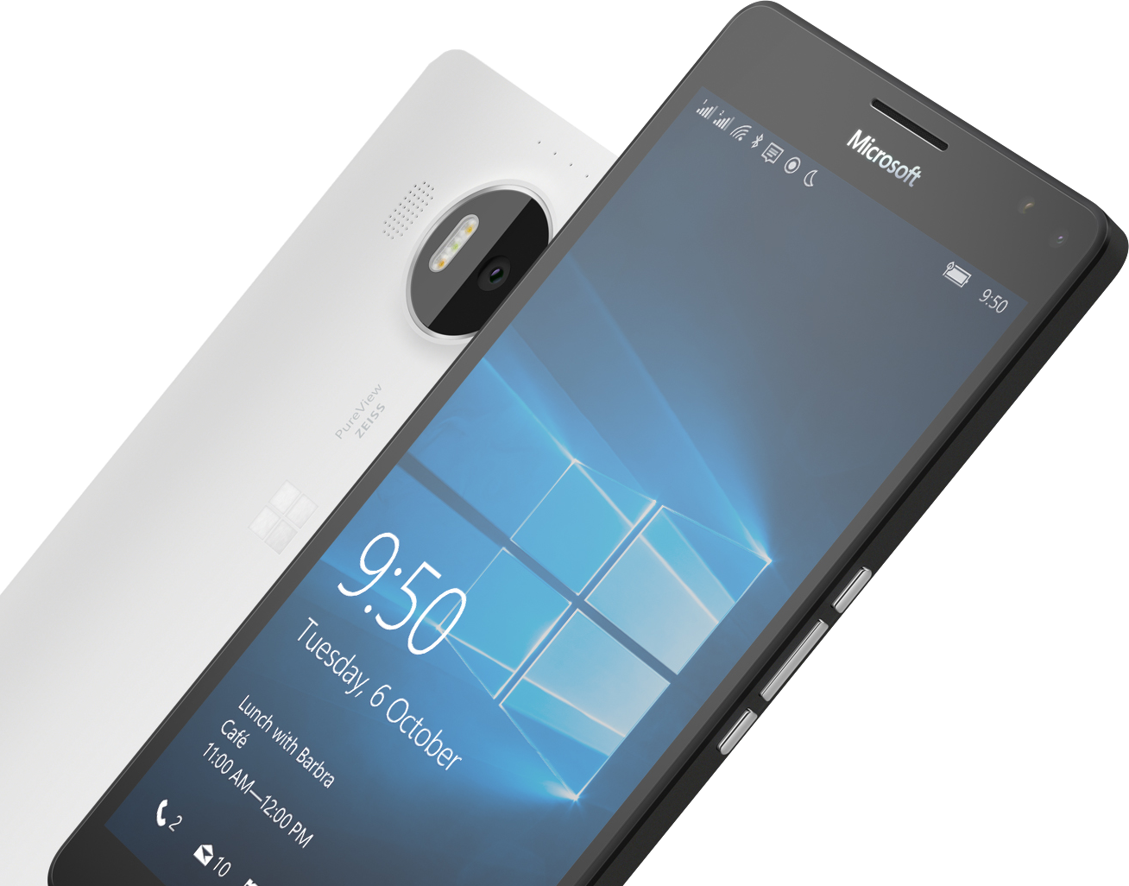
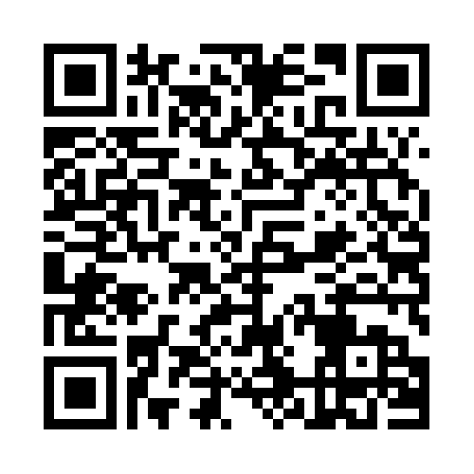

Please Complete An Evaluation Form Your input is important!
Required Slide
*delete this box when your slide is finalized
SAMPLE
or
Notes:
Update phone image to a Microsoft phone.

